Slide 1
Camply
For campers by campers

Slide 2
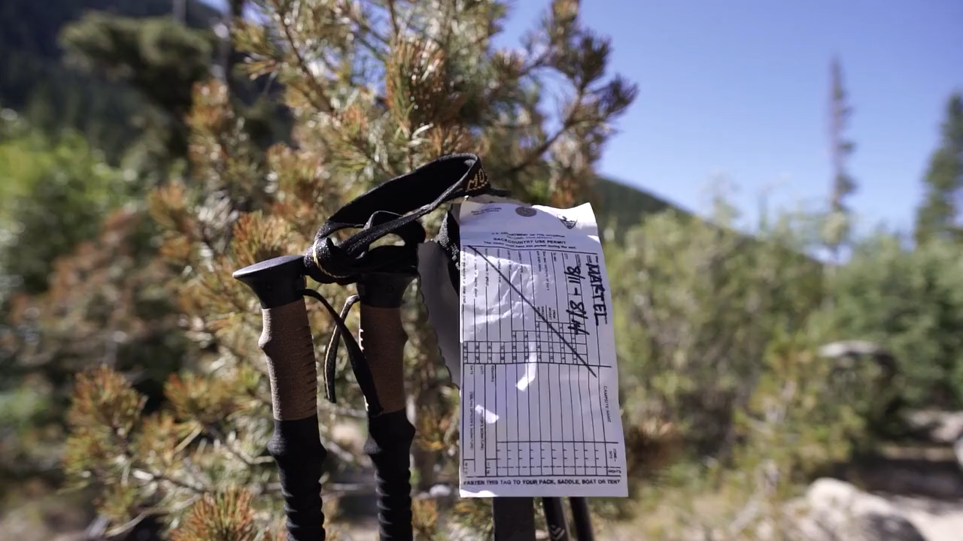

Slide 3

Project in detail:
We are building a campsite website for users to publish campsites.
Users will be able to, edit their comments to give opinion for other campers to get an idea about comment on campsites the campsite that they view.

Slide 4
Things to be completed by the milestone presentation: (User Stories)
Developing front end of the project (HTML-CSS as EJS)
Developing back end of the project (Backend JavaScript as NodeJS)
Building database which is preferred as NoSQL (MongoDB)
Designing Homepage Login
Designing Campsite Index Page
User/Admin Permissions

Slide 5
Collaborators:
Tugberk GOC – 115200084
Arda CAKMAKLI – 116202023
Suat Burak OZAYDIN -- 114202037
Mert YUKARIKOZA --

